Slide 1
A LITERATURE REVIEW ON CURRENT APPROACHES AND APPLICATIONS OF FUZZY EXPERT SYSTEMS Group members : RUCHA TIRODKAR BE B 26 PIYUSH VERMA BE B 24 ARJUN BHARDWAJ BE B 13 VISHAL PATIL BE B 05
Guide : Prof. Surekha janrao

Slide 2
INDEX
Sr No. | CONTENT
1 | ABSTRACT
2 | INTRODUCTION
3 | WHAT IS FUZZY EXPERT SYSTEM ?
4 | WHY IS FUZZINESS REQUIRED IN EXPERT SYSTEM ?
5 | AI AND SC IN HEALTHCARE DEPARTMENT
6 | WHY TO USE A FUZZY EXPERT SYSTEM IN MEDICAL FIELD
7 | FUZZY SYSTEMS ANALYSIS AND LITRATURE STUDIES
8 | WELL KNOWN SECTORS THAT USE FUZZY EXPERT SYSTEM
9 | FUZZY LOGIC IN FINANCE AND MANAGEMENT
10 | PROBLEMS AND SOLUTIONS
11 | APPLICATION OF FUZZY EXPERT SYSTEM IN FINANCE
12 | ADVANTAGES AND DISADVANTAGES OF FUZZY SYSTEM
13 | OTHER APPLICATIONS
14 | CONCLUSION
15 | REFRENCES

Slide 3
ABSTRACT
The main purposes of our study is to distinguish the trends of research in publication for the utilizations of the fuzzy expert and knowledge-based systems that is done based on the classiﬁcation of studies in the last decade. The investigation covers articles from related scholastic journals, International conference proceedings and some major literature review papers. The outcomes reveal an upward trend in the up-to-date publications number, that is evidence of growing notoriety on the various applications of fuzzy expert systems. This raise in the reports is mainly in the medical neuro-fuzzy and fuzzy expert systems. Moreover, another most critical observation is that many modern industrial applications are extended, employing knowledge-based systems by extracting the experts’ knowledge.

Slide 4
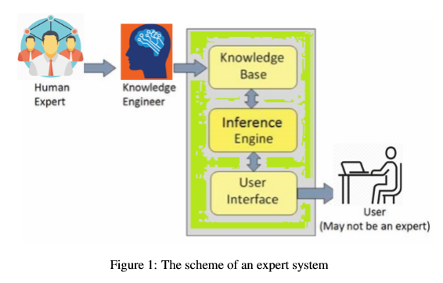
INTRODUCTION
Expert systems are the division of Artiﬁcial Intelligence (AI) which advances widespread use of techno-scientiﬁc human expertise to resolve semi or ill-structured problems where there is not a speciﬁc guaranteed for solving the algorithm. The expert systems have been characterized as a smart program that applies knowledge and inference steps to handle difﬁcult problems to need important human expertise for their solutions.

Slide 5
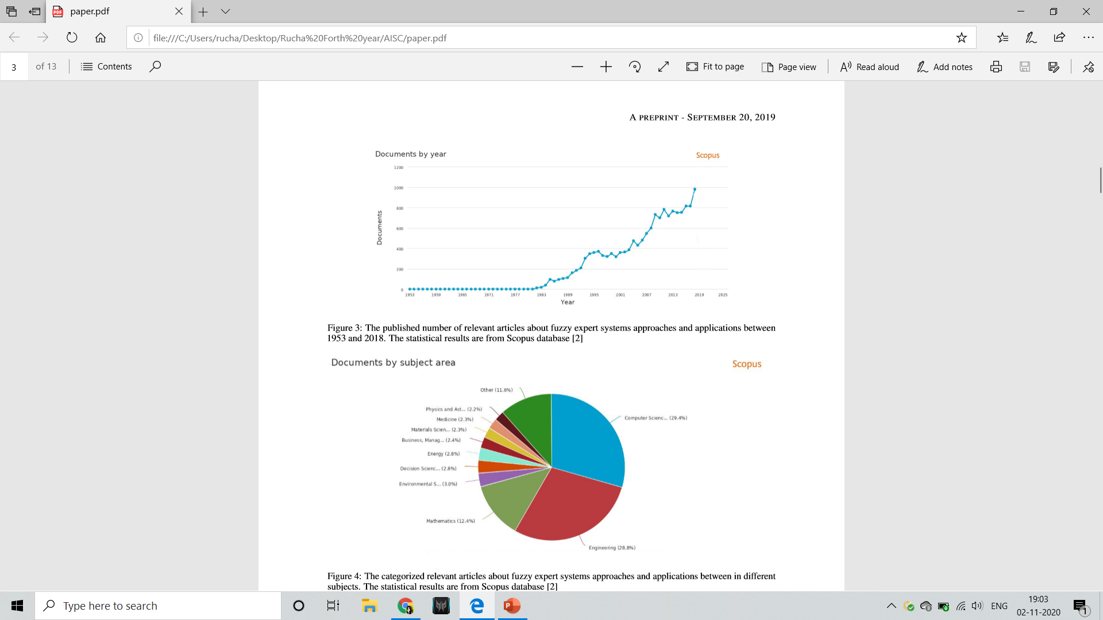
Introduction continued
Despite some ﬂuctuations in the growth trend of fuzzy expert systems publications, the overall trend has been excessively increasing between1983 and 2018 with the number from less than ten papers to more than 1000 publications per year. The main objective of this article is to discuss the principal beneﬁts and shortcomings of the current approaches and theories for improving and modelling fuzzy expert systems in different areas such as medicine and business.

Slide 6


Slide 7
WHAT IS A FUZZY EXPERT SYSTEM?
• In every domain, there exist someone who has a certain amount of knowledge about certain parts of the domain.
• However, it might not be possible for every person to master every knowledge in that domain.
• Experts are defined as per their capability to solve a particular task of that domain.
• To combine the ability of problem solving using knowledge and the speed and accuracy of computers, Expert systems are created.
DEFINITION:
A fuzzy expert system is an expert system, which is composed of fuzziﬁcation, inference rules, knowledge database, and defuzziﬁcation parts, and employs fuzzy logic rather of the Boolean logic to deliberate about data in the inference mechanism. This procedure is adopted to explain decision-making problems, where there is no accurate algorithm exists, although instead, the problem solution can be estimated heuristically, which is depends on experts in the form of If-Then rules. A fuzzy expert system can be fully satisﬁed to the problem, which shows uncertainty emanating from fuzziness, uncertainty or subjectivity.

Slide 8
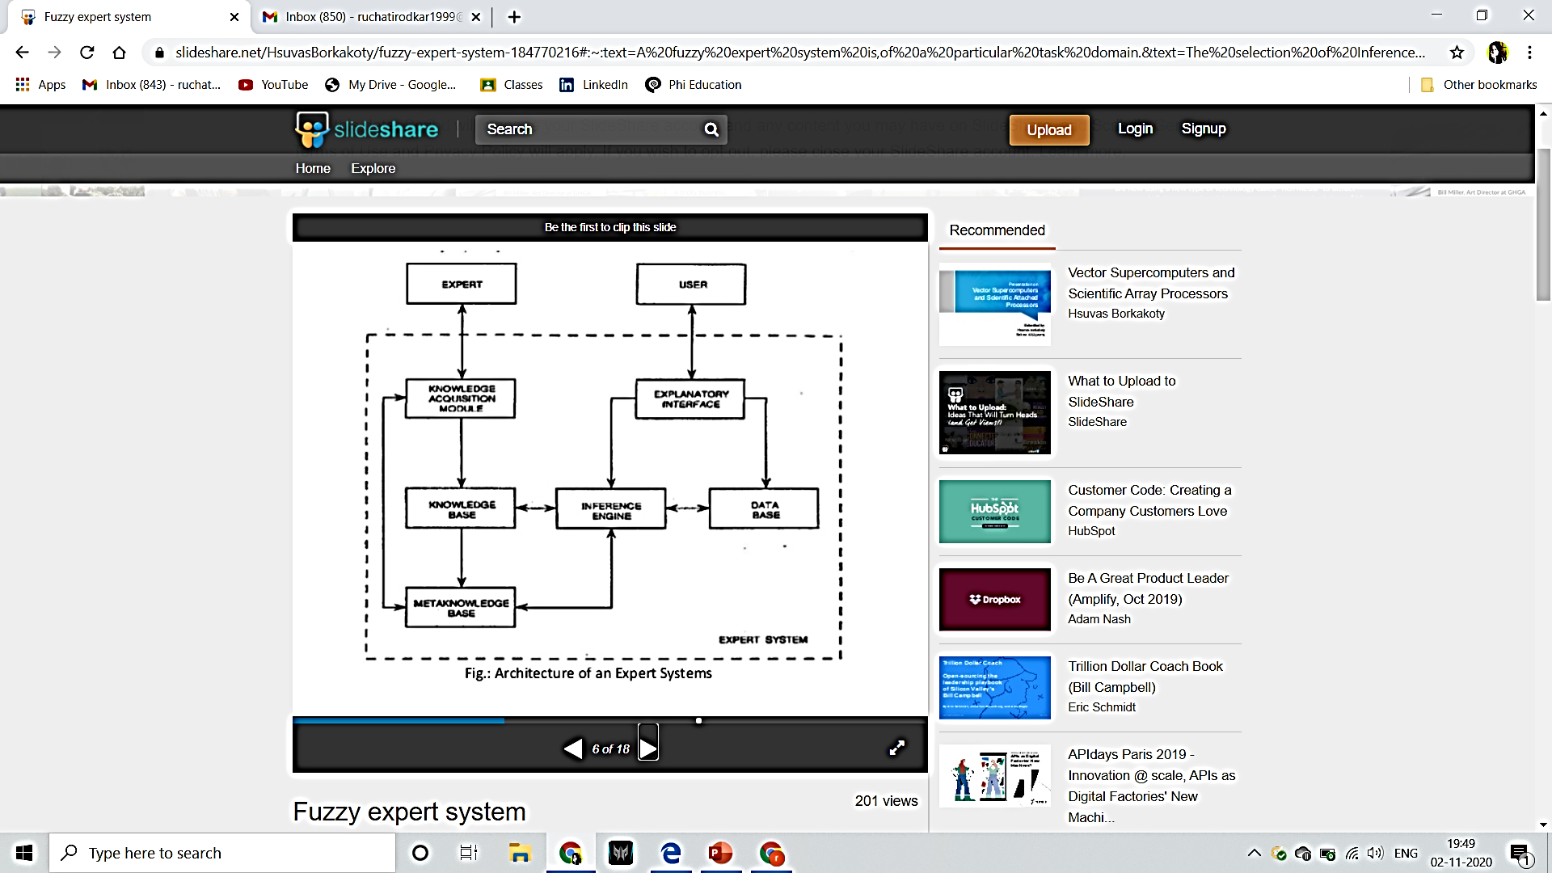
EXPERT SYSTEM ARCHITECTURE

Slide 9
Why fuzziness is necessary?
-Because of the imprecision and uncertainty that might arise in various situations and might impact negatively on decision making capability.
- To introduce this imprecision and uncertainty, fuzziness is to be involved in decision making process.
- Expert systems solves problems that are normally solved by human experts and there can be factors affecting inference knowledge that’s why fuzziness in expert system is introduced
Now we will discuss on application of these fuzzy expert system in Medical and Finance field.

Slide 10
How Artificial intelligence and Soft computing is used in Healthcare department :
AI-assisted robotic surgery
Virtual nursing assistants
Image analysis
Diagnostic of deadly blood diseases faster

Slide 11
FUZZY EXPERT SYSTEMS IN MEDICAL FIELD
Why is fuzzy expert system used in medical sector:
To deal with inconsistencies of reports.
Treatment planning.
Advisory, monitoring, and control of systems.
Parameters predictions.
Artificial thinking.

Slide 12
FUZZY EXPERT SYSTEMS analysis and literature studies in medical field:
In the last three decades, Fuzzy rule-based systems is a subsidiary of Artiﬁcial intelligence ﬁtted of interpreting complicated medical data. Their potential to employ signiﬁcant relationship within a data set has been used in the diagnosis, treatment and predicting consequence in various clinical outlines. A survey of different artiﬁcial intelligence methods is exhibited in this part, along with the study of critical clinical applications of expert systems. The ability of artiﬁcial intelligence systems and has been explored in almost every ﬁeld of medicine. Artiﬁcial neural network and knowledge based systems were the most regularly accepted analytical tool while additional AI systems such as evolutionary algorithms, swarm intelligence and hybrid systems have been handled in various clinical environments.

Slide 13
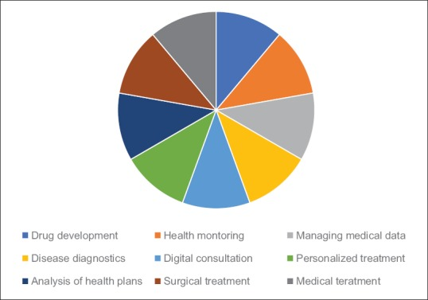
Well known sectors of medical field that uses FUZZY EXPERT SYSTEM

Slide 14
Fuzzy Logic in Finance and Management
The major success of fuzzy logic in the field of remote control opened the door to its application in many other fields, including finance but the foot-print has been almost been non existent.
Fuzzy logic has been successfully applied in the field of finance due to its ability to address imprecise, incomplete and vague data. However, there hasn’t been much use of fuzzy logic in resolving bank crisis.
This absence could be seen as a contradiction, given the properties of fuzzy logic, which seem to fit particularly well in complex and uncertain environments.

Slide 15
Problems and solutions
Since the global financial crisis, preventing banking crises and establishing banking resolution strategies to avoid the use of public money to rescue banks have been the main priorities within the area of finance.
Introducing fuzzy logic and FUZZY EXPERT SYSTEM to the analysis of banking crises could represent an important step towards addressing and resolving banking crises more efficiently.

Slide 16
Application of systems in finance field
The most frequent topic in which fuzzy logic has been applied in the field of finance is financial markets, with approximately 60% of the total articles classified in this category, followed by corporate finance, with approximately 35%. The remaining articles focused on public finance (3%), personal finance (1%) and other topics (2.52%). This fact clearly underscores the focus of the academic research on financial markets and corporate finance, and it can be explained by the greater volume of publicly available data in these fields compared with other areas, such as personal finance.

Slide 17
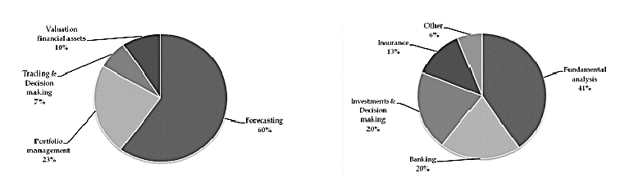
Categorization of the main topics usually analysed when applying fuzzy logic in finance: (a) Category of financial markets, and (b) category of corporate finance.

Slide 18
Advantages of FUZZY EXPERT SYSTEMS
Can work on a wide range of problems with uncertainty.
Universal function approximation.
Comprehensibility Modularity.
Explainability.
Easy handling and easy integration with Expert system.

Slide 19
Disadvantages of FUZZY EXPERT SYSTEM
High computational cost
The rules have to be accurate
Optimisation
Avoiding error in knowledge base is mandatory for Fuzzy system to give accurate result.

Slide 20
Other applications of Fuzzy systems
Agriculture field
- CLEAX for growers, advisors and managers.
VAREX- enables selection of the best cultivators for diverse cultural situation.
Education
Can be used in performance evaluation at different parameters.
Environmental Management
Cost effective integrated environmental monitoring system.
Sports
Goalkeeper quality recognition.

Slide 21
Conclusion
• Fuzzy Expert Systems are one of the major game changers in the area of computation.
• It's way of dealing with uncertainty and using that in problem solving process is highly remarkable.
• However, it has various overheads and difficulties also.
• To design a system that overcomes these overheads and provides an efficient solution regarding its task domain is a very important and challenging task.
• If able to do so, it will provide an unmatched power to the problem solving domain.

Slide 22
References
[1] Expert systems in the 1980s. State of the art report on machine intelligence. Maidenhead: Pergamon-Infotech, 1981.
[2] Judy F Burnham. Scopus database: a review. Biomedical digital libraries, 3(1):1, 2006.
[3] Lotﬁ A Zadeh. Soft computing and fuzzy logic. In Fuzzy Sets, Fuzzy Logic, and Fuzzy Systems: Selected Papers by Lotﬁ a Zadeh, pages 796–804. World Scientiﬁc, 1996.
[4] William P Wagner. Trends in expert system development: A longitudinal content analysis of over thirty years of expert system case studies. Expert systems with applications, 76:85–96, 2017.
[5]Hepatitis disease diagnosis using a new hybrid system based on feature selection (fs). DigitalSignalProcessing,16(6):889–901, 2006.
[6] Kemal Polat, Salih Günes¸, and Sülayman Tosun. Diagnosis of heart disease using artiﬁcial immune recognition system and fuzzy weighted pre-processing. Pattern Recognition, 39(11):2186–2193, 2006.
[7] Kemal Polat, Seral S¸ahan, and Salih Günes¸. A new method to medical diagnosis: Artiﬁcial immune recognition system (airs) with fuzzy weighted pre-processing and application to ecg arrhythmia. Expert Systems with Applications, 31(2):264–269, 2006.
[8] Kemal Polat and Salih Günes¸. An expert system approach based on principal component analysis and adaptive neuro-fuzzy inference system to diagnosis of diabetes disease. Digital Signal Processing, 17(4):702–710, 2007.
[9] SeralS¸ahan,KemalPolat, HalifeKodaz,andSalihGünes¸. Anewhybridmethodbasedonfuzzy-artiﬁcialimmune system and k-nn algorithm for breast cancer diagnosis.
[10] Kemal Polat and Salih Günes¸. Artiﬁcial immune recognition system with fuzzy resource allocation mechanism classiﬁer, principal component analysis and fft method based new hybrid automated identiﬁcation system for classiﬁcation of eeg signals. Expert Systems with Applications, 34(3):2039–2048, 2008.

Slide 23
THANK YOU

Slide 24
Any Questions ?

